Slide 1
Basic Java

Slide 2



An arrow pointing

Slide 3


Slide 4


Reassignment and Immutable Values

Slide 5

Mutable Values

Slide 6

Unreassignable references

Slide 7

== vs. equals()

Slide 8
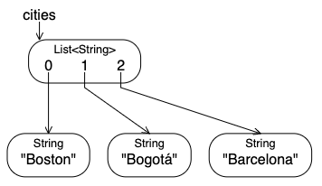
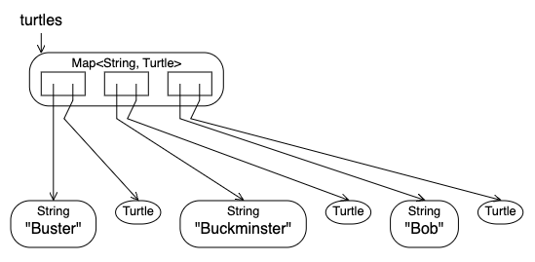
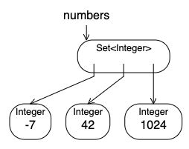
List, Set, Map

